Slide 1



Building Real-time games with .NET MAUI
Shaun Lawrence
(he/him)
@bijington

Slide 2
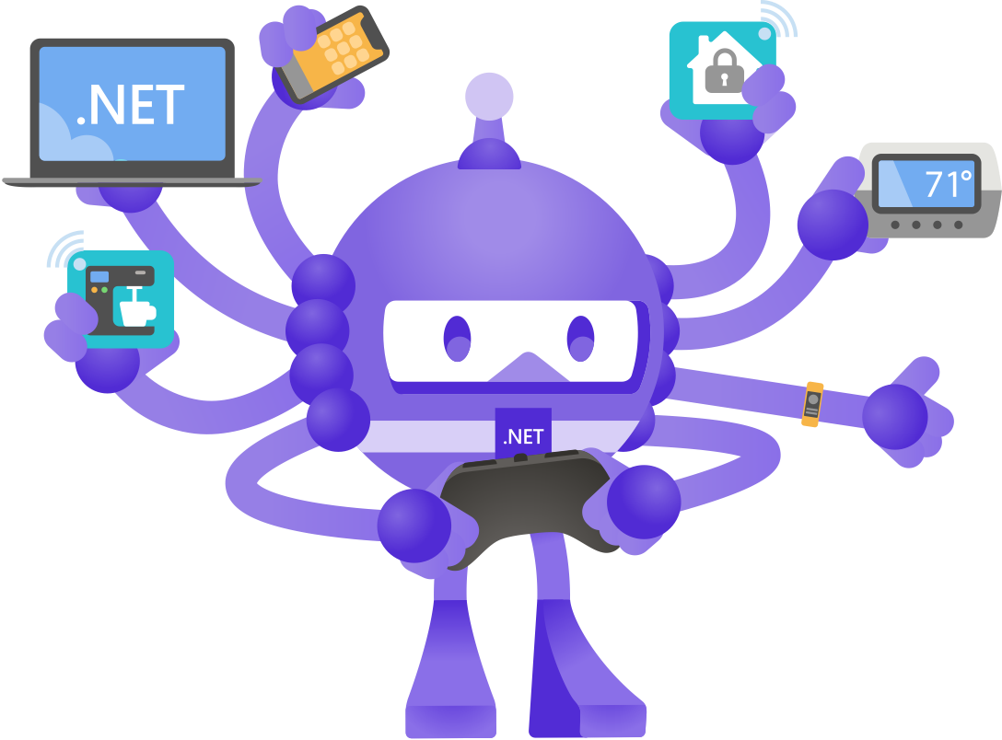
What is .NET MAUI?
Multi-platform App UI
Cross-platform framework
Mobile - Android and iOS
Desktop - macOS and Windows
Fridge/TVs - Tizen
It is the evolution of Xamarin.Forms
First release is Version 6
Finally a first class citizen of the .NET ecosystem
@bijington

Slide 3
What is SignalR?
Open-source
ASP.NET Core
Real-time communication
Bi-directional connection
Scalable
Manages complexity for us
Authentication
Authorization
Streaming
@bijington

Slide 4
How to use SignalR?
SignalR Server
Hub
@bijington

Slide 5
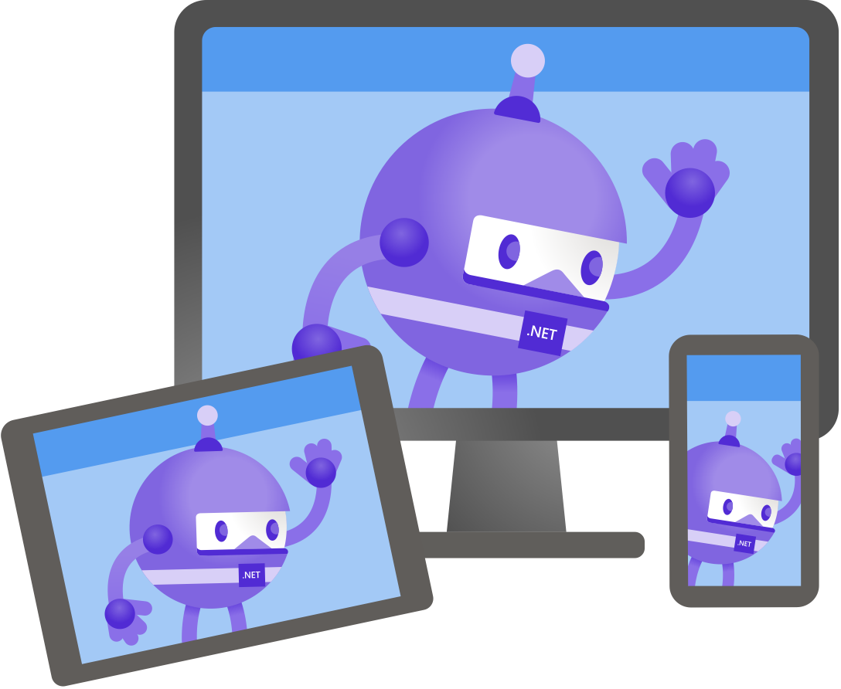
What happens when we combine .NET MAUI and SignalR?
Demo
@bijington

Slide 6
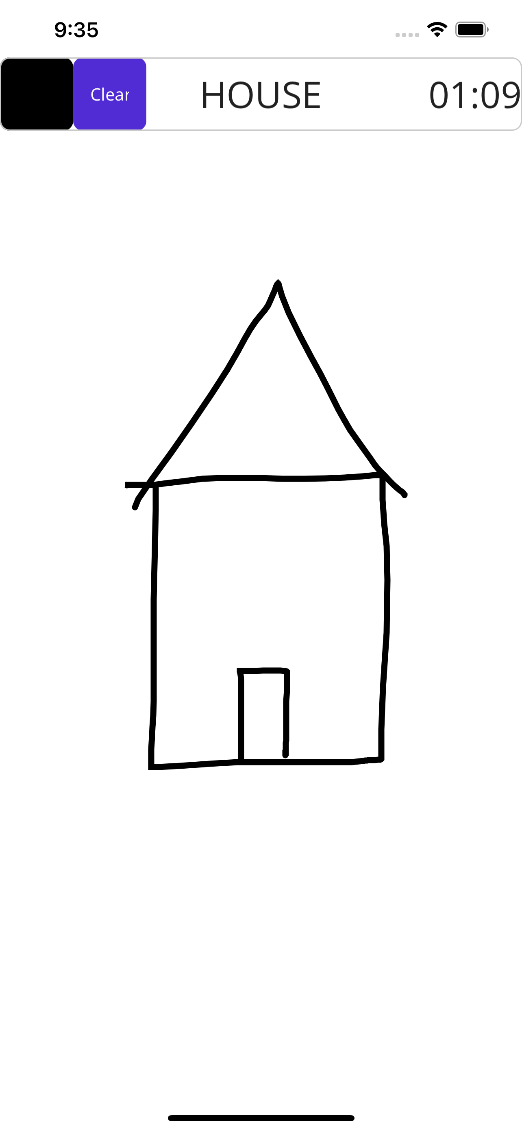
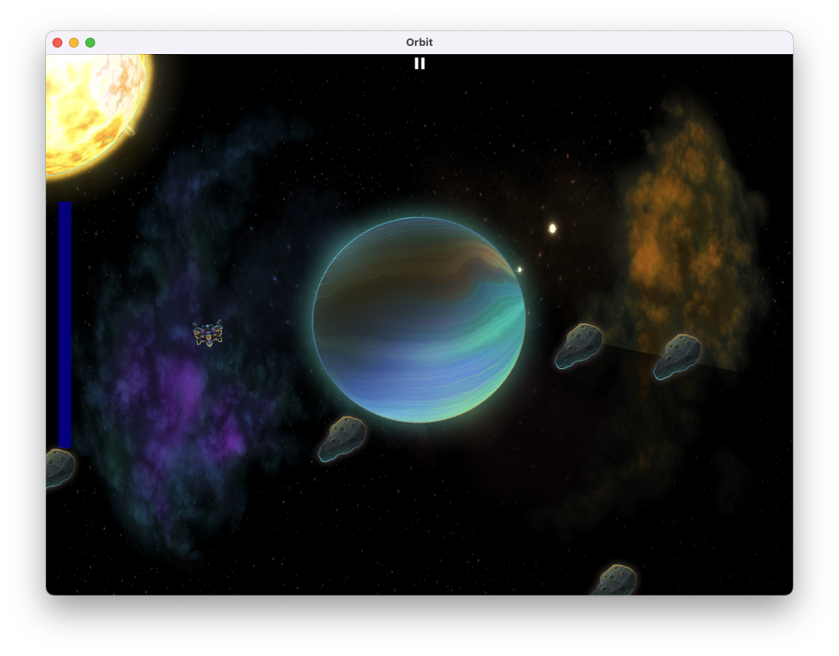
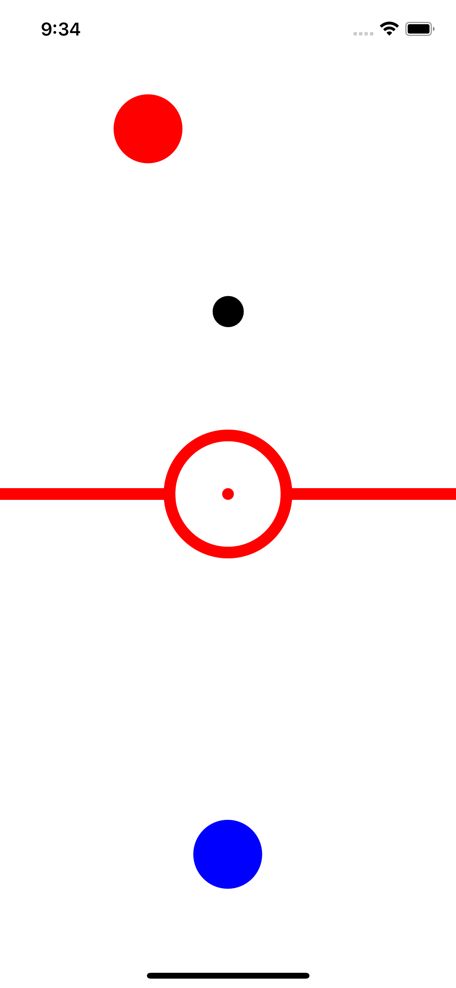
Building games in .NET MAUI?
Journey to build a 2D game engine
Utilizing best bits of .NET MAUI
https://github.com/bijington/orbit
Fun in the building
@bijington

Slide 7
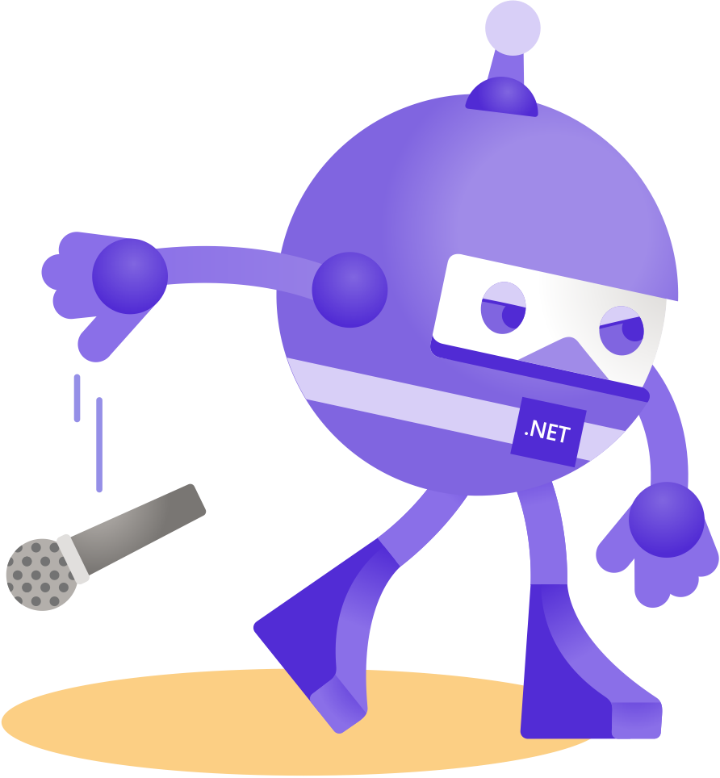
Thanks for joining!
Ask your questions live on Twitter #dotNETConf
@bijington

